Slide 1


Experiences, not Apps:
Microfrontends and their BFFs
Colin Young
2/19/25

Slide 2



$ whoami
github.com/colinyoung
Consultant, 2015
Engineering Mgr, 2021
Software Engineer, 2024

Slide 3
Most teams that use microservices mostly just use them on the backend.
Promise: Increased agility, decreased release times, and improved separation of concerns.
Opportunities: Code reuse, language-agnosticism, full-stack empowerment, and much more.
Challenges: discoverability, documentation, enforced contracts, testing, and of course, more.

Slide 4

Microservice transformations…
you hate to see it
How to break the monolith
Identify domains
Separate data
Identify dependencies
Make APIs
https://insights.sei.cmu.edu/blog/8-steps-for-migrating-existing-applications-to-microservices/
Martin Fowler

Slide 5
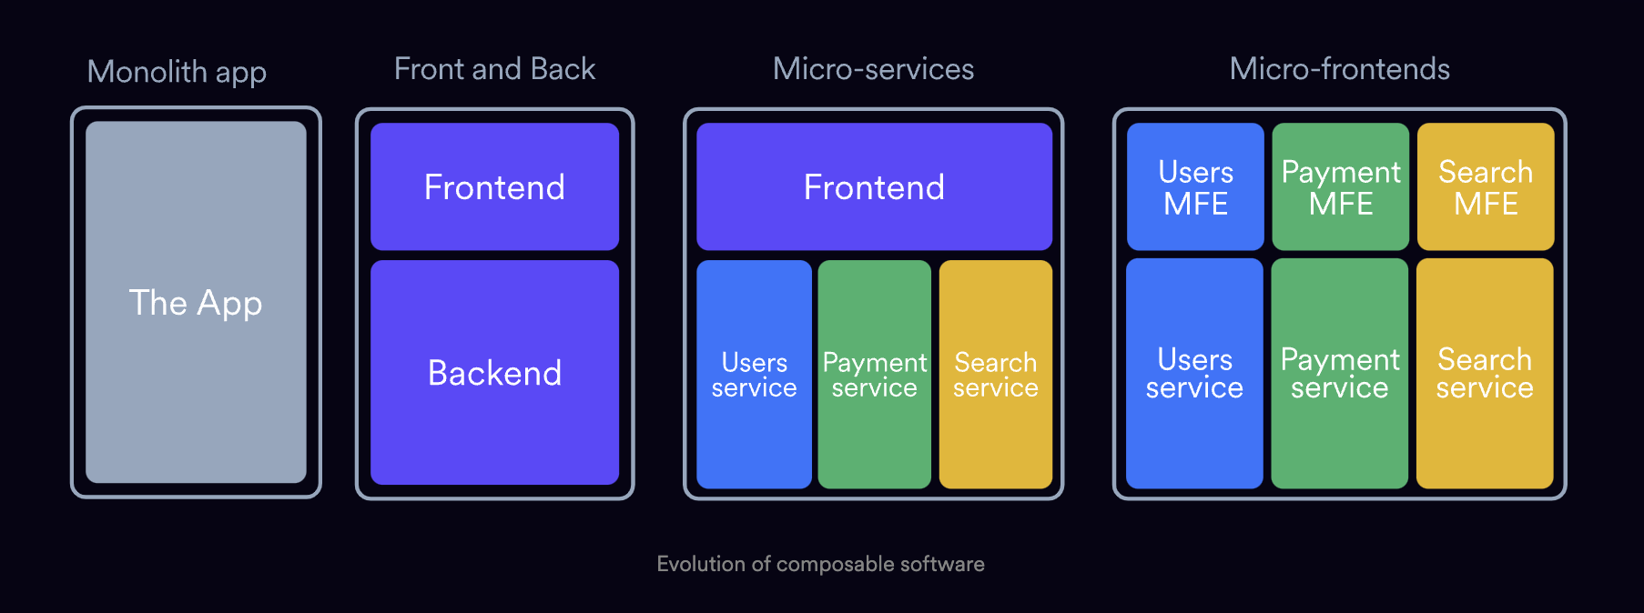
Source: bit.dev

Slide 6
Microfrontends are microservices too.
Separates concerns into experiences
Clearly library vs. UI code
Can be released separately
Optimized bundle size rather than giant artifacts

Slide 7
Backends-for-frontends
Sam Newman
Small and fast
Run wherever you want, but make it simple
Can do the dirty work of hitting multiple services
Basically serve two purposes:
Provide UI-driven types/schema
Safety when things change
Just like other microservices, they can be released separately and contract-tested

Slide 8
The microservice
https://api.yourco.com/
v1/loan-applications
The BFF
https://api.yourco.com/bffs/apply-for-credit/*
The experience
https://js.yourco.com/
apply-for-credit.min.js

Slide 9
In action
Introduce your MFEs to their BFFs

Slide 10
How to start
Define your Jobs To Be Done .
Take, for example, a lending company’s monolithic React app fed by microservices.
Loan
Applicants
Estimate Your Payment
Apply for Credit
Service Payments
Sign Your Loan
Learn how to Embed Your Credit App
Customize their Co-Branding
Lead Gen
Partners
See Referral Stats
Do Standard SaaS Stuff
Notes:
This pattern might apply to a lot of SaaS business like insurance, e-commerce, payments, etc.
https://jobs-to-be-done.com/jobs-to-be-done-a-framework-for-customer-needs-c883cbf61c90

Slide 11
Map your micros
Your Giant React App
User App
Partner App
User Experiences
User Experiences
<ApplyForCredit />
/bff/* ➡ //yourapi.com/apply-for-credit/
<ApplyForCredit />
/bff/* ➡ //yourapi.com/apply-for-credit/
<ApplyForCredit />
/bff/* ➡ //yourapi.com/apply-for-credit/
<HelpMeIntegrate />
/bff/* ➡ //yourapi.com/integrations/
Notes:
Obviously bigger than just this

Slide 12
Map your micros, part 2
Frontend
Estimate.tsx
CreditApp.tsx
LoanDoc.tsx
MakePayment.tsx
Estimate MFE
Apply MFE
Sign MFE
Pay MFE
Old stuff
Backend
/estimates
/credit
/loan
/payment
Estimate BFF
Apply BFF
Sign BFF
Pay BFF
Notes:
This pattern might apply to a lot of SaaS business like insurance, e-commerce, payments, etc.
https://jobs-to-be-done.com/jobs-to-be-done-a-framework-for-customer-needs-c883cbf61c90

Slide 13
Migrating to microfrontends
Monorepo transformation
Table stakes
Deployment options
Webpack Module Federation
Bit, Vercel MFEs, etc.
Separation of concerns
Shell app + micros
Focus on JTBDs with disparate business logic
Bundle optimization
Import Maps
Tree shaking
Complementary to microservices
Domain-based MFEs
BFFs
Notes:
Common components - chrome
Miniapps - often on their own route. Often only used by one user type.

Slide 14
Tips
Think small
Build both MFEs and BFFs as tiny as humanly possible
Enables rapid iteration and comprehensive testing
Think fast
How can you proxy existing services?
Think even faster
Can you leverage PaaS?
MFEs w/ collections + functions (i.e. Firebase), not even BFFs
Organize by project
Think shared
Design systems/UI libraries
Notes:
Common components - chrome
Miniapps - often on their own route. Often only used by one user type.

Slide 15
Bringing everyone together
Your team, too

Slide 16
Put simply
1
2
3
4
5
Now…
Identify shared chrome
Define experiences using jobs-to-be-done
Come up with schemas using product requirements
Make BFFs for experiences (figure out services they hit)
Setup release pipelines and testing
Frontend can build UI without waiting on anybody
Backend knows they won’t break anything
You can actually continuously deploy for the first time in your life

Slide 17
That’s nice, but
How do I actually do it?

Slide 18
Monorepo
Source
CI
CD
packages/
estimate/
bff/
mfe/
apply/
bff/
mfe/
contracts/
estimation/
pact.json
test.ts
apply/
pact.json
test.ts
services/
estimation-svc/
credit-app-svc/
.github/workflows
test-pkg.yml
test-svc.yml
test-contracts.yml
test.yml
FE: Vercel
1. Frontends
2. Functions
BE: Next + Docker
Or your choice
PaaS/IAC
Notes:
Common components - chrome
Miniapps - often on their own route. Often only used by one user type.

Slide 19
What do you get out of this relationship?
BE-driven schemas
Gotta build dependencies
Stateful
Huge regressions
Single pipeline
Single surface
UI-driven schemas
Shared types
Stateless
Ship separately
Multiple pipelines
Any surface

Slide 20
Tips to succeed
Sam Newman
Get product folks to be advocates
Get buy-in from devops, backend, and QA
For design, use Storybook
Implement contract testing (e.g. Pact)

Slide 21
Build with AI
This is all ideally suited to AI workflows

Slide 22
AI works best with structure
Contract testing → contract-driven-development
BFFs: perfect for codegen
MFEs with common UI: perfect for codegen
Agentic loops, even

Slide 23
Iteration loop
Define JTBD + schema
Test
Create contracts
Develop

Slide 24
Gotchas
Nobody’s perfect

Slide 25
Gotchas
BFF RBAC
One mitigation: detailed JWTs
Session Handling
AaaS as possible
Time-to-market
Don’t be a tiny startup
Backend-team adaptation
Get frontend involved
CSS
Make sure to reset and namespace

Slide 26
That’s it!

